Slide 1
Ruby Terminal App
TV Show Organiser
Developers:
Holly King
Kieran Lockyer

Slide 2
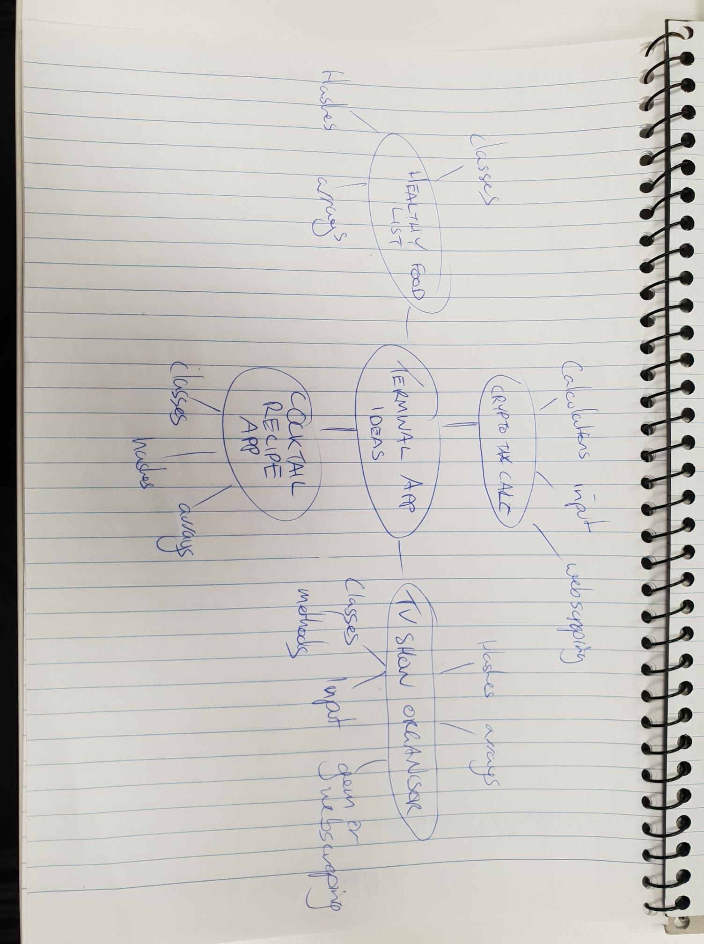

Brainstorming
Initial ideas:
Crypto Currency Tax Calculator
Web scraping was essential
TV Show Organiser
Would require classes and web scraping (optional)
Cocktail Recipe Library
Hardcoded Library with hashes and arrays
Health Food App
Same as above

Slide 3
Why We Chose TV Show Organiser
TV Show Organiser had the most pros going it’s way:
Solving a real world problem
Option to add web scraping, but not essential
Used the most of our knowledge, without overcommitting.
Fun!

Slide 4

1. Development
Thought of Possible Use cases - Multiple shows being tracked
- Multiple users with different shows
Created User Workflow - What is the most logical way to step through the menu
Broke Problems Down Into Features and Stories - Which features are essential and which can we get away with adding later or not implementing at all.

Slide 5
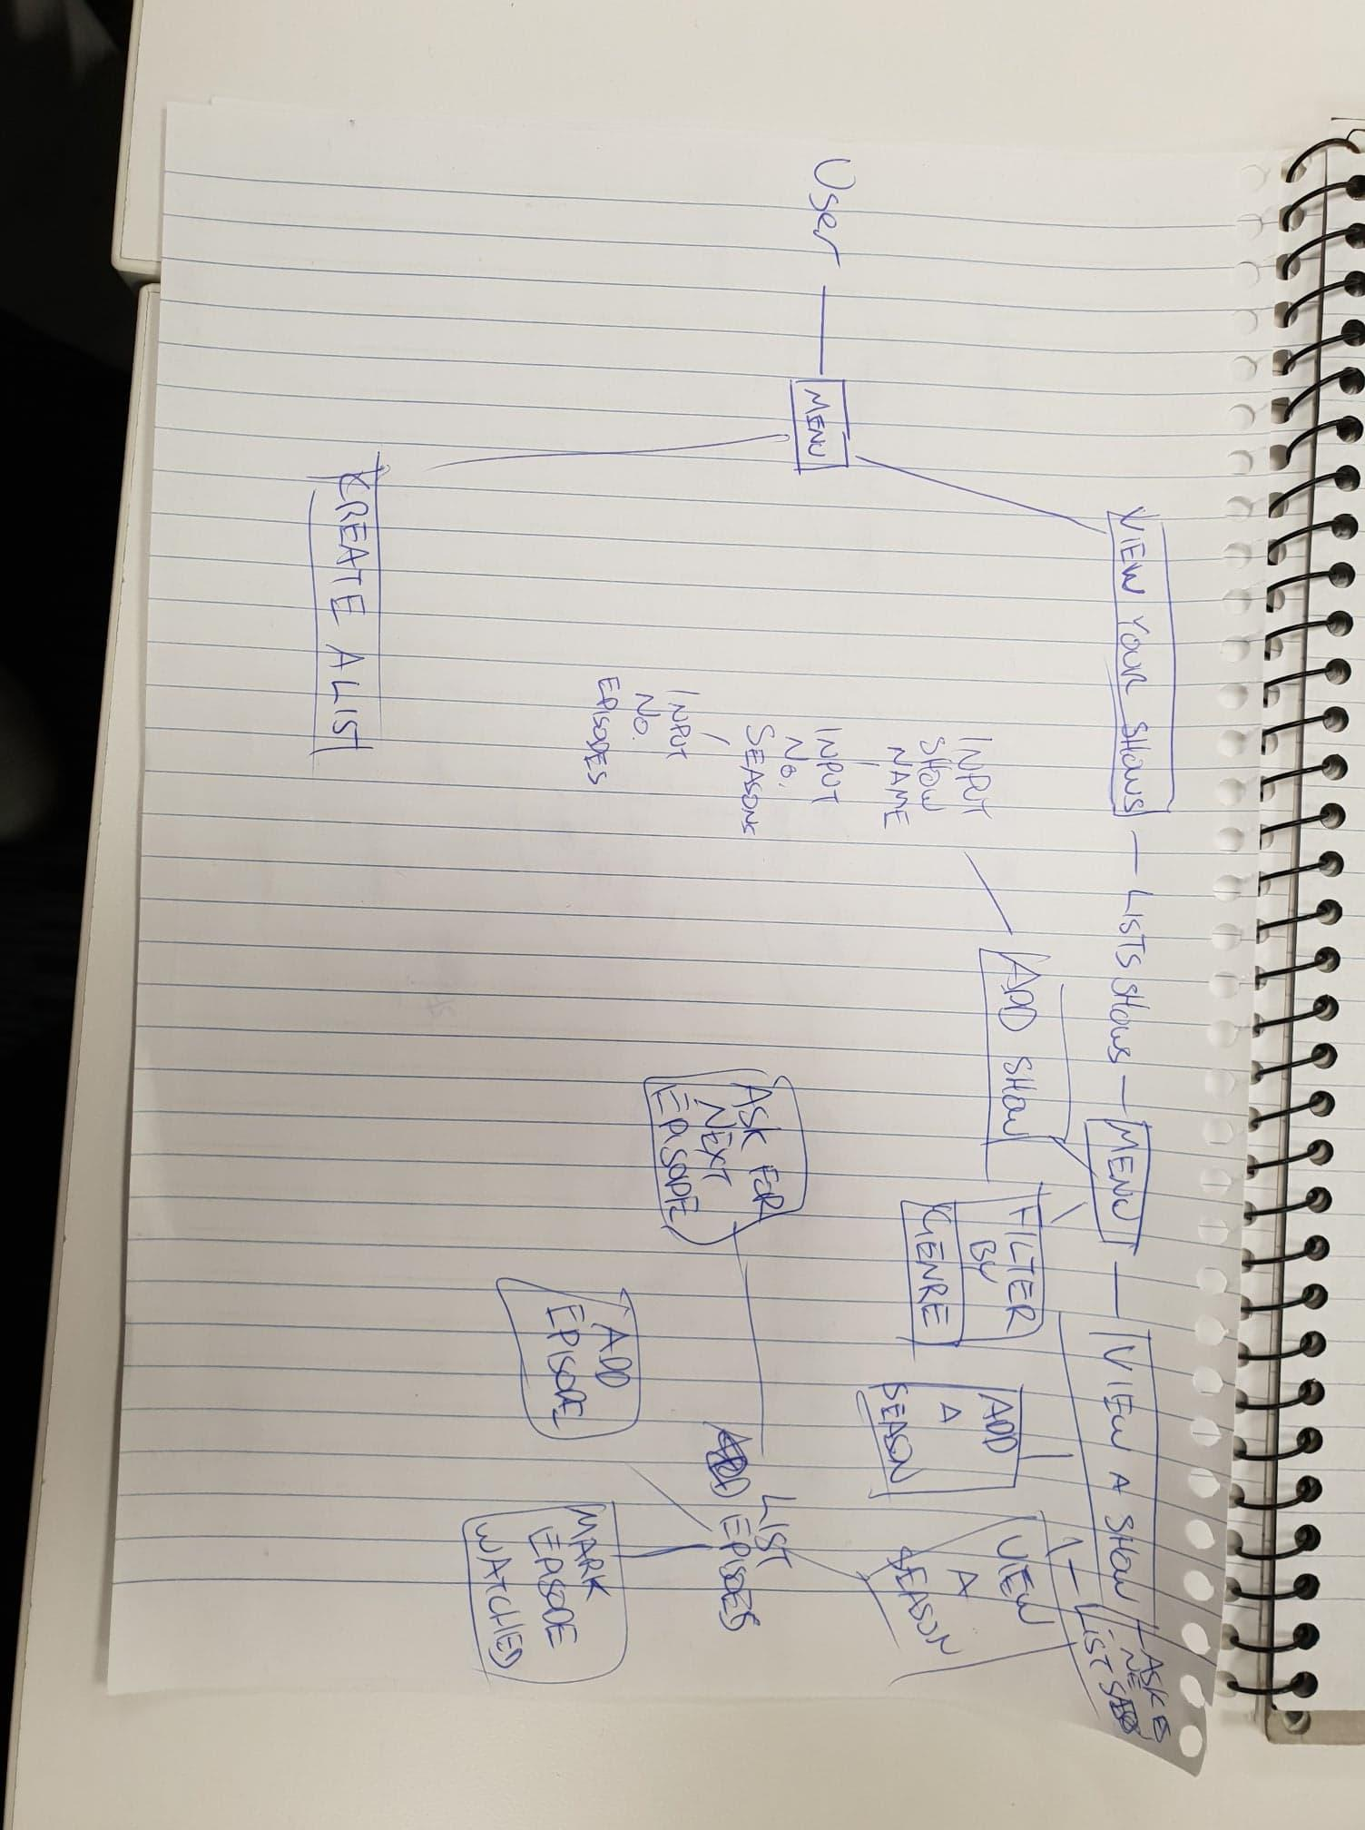
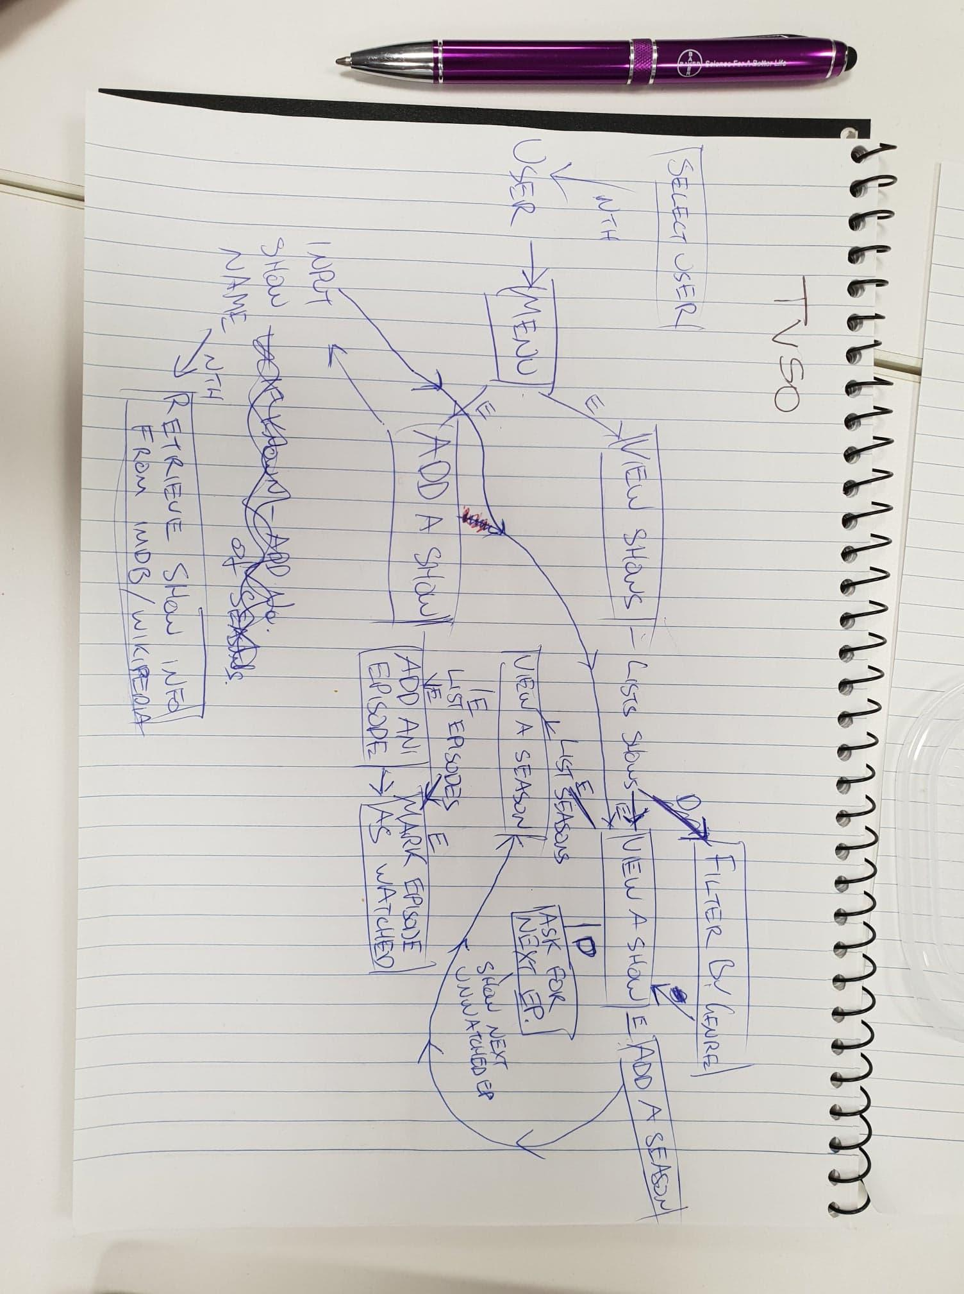
Workflow Versions

Slide 6
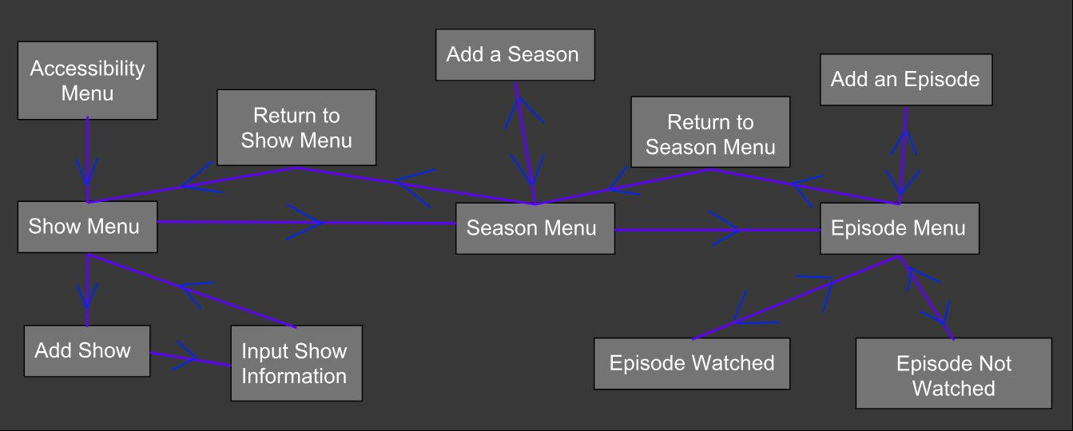
Final Workflow Version!

Slide 7
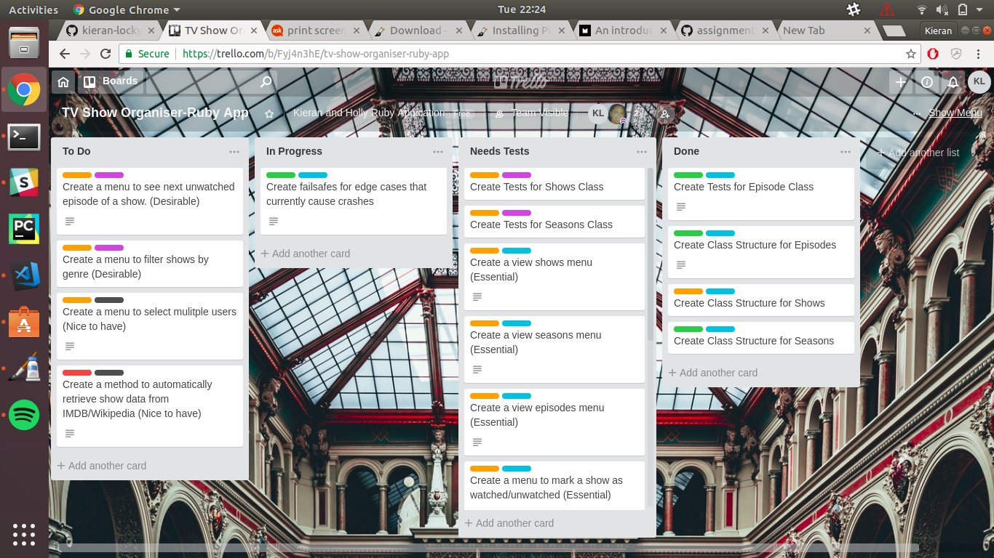
Stories
We used Trello to track our stories
As a user of the app I want to be able to:
Add Shows to track
Add different numbers of seasons to different shows
Add different numbers of episodes to different seasons
Not be confused when navigating the menus
Be able to easily set show as watched
Undo watching a show if I set it as watched by mistake
Remove shows when I’m done watching them

Slide 8
2. Starting to code
First step is to think about how to structure the data - Episodes, Seasons and Shows as classes
- Menu could be functions or class
- Seasons and Episodes stored in arrays.
Next we wrote some kick ass tests! - Testing is hard!!!
Then we proceeded to break everything and get headaches aka - Palm’s are sweaty, code spaghetti

Slide 9
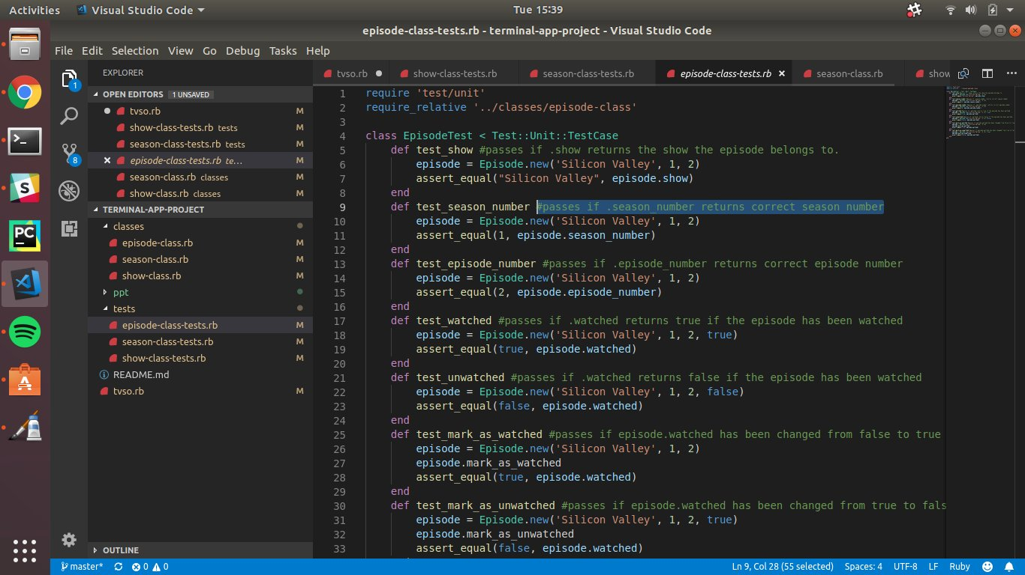
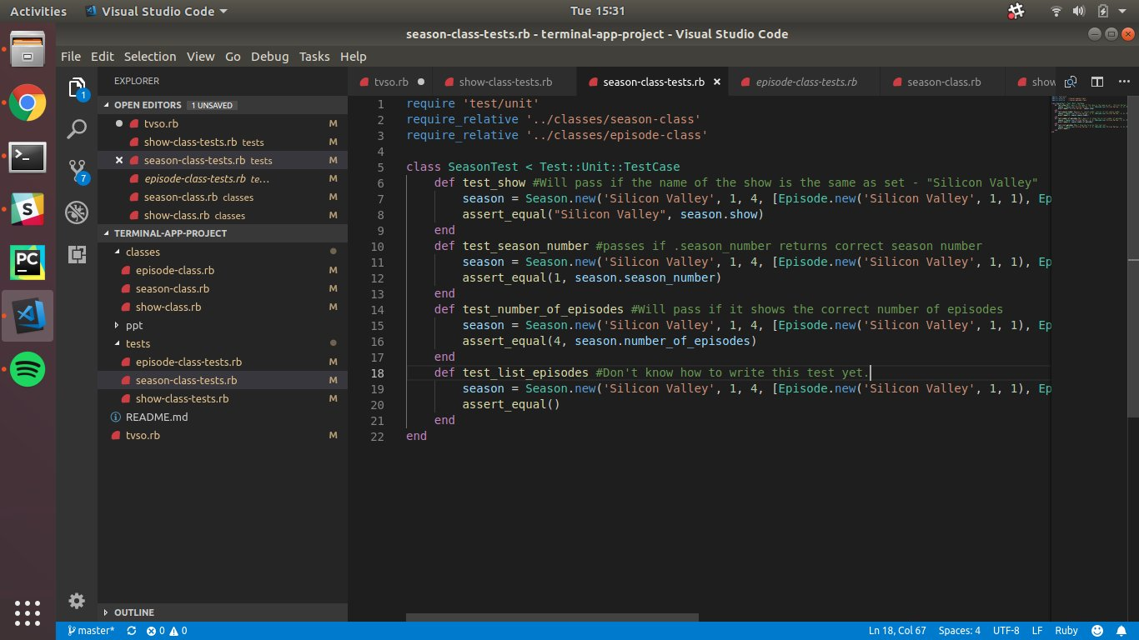
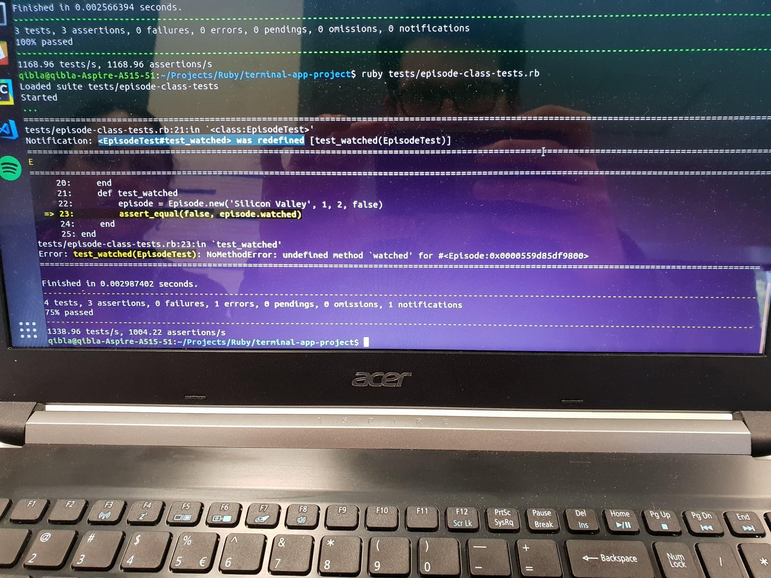
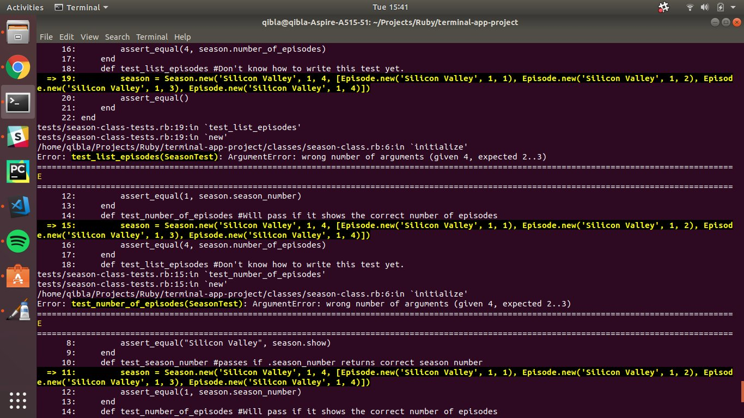
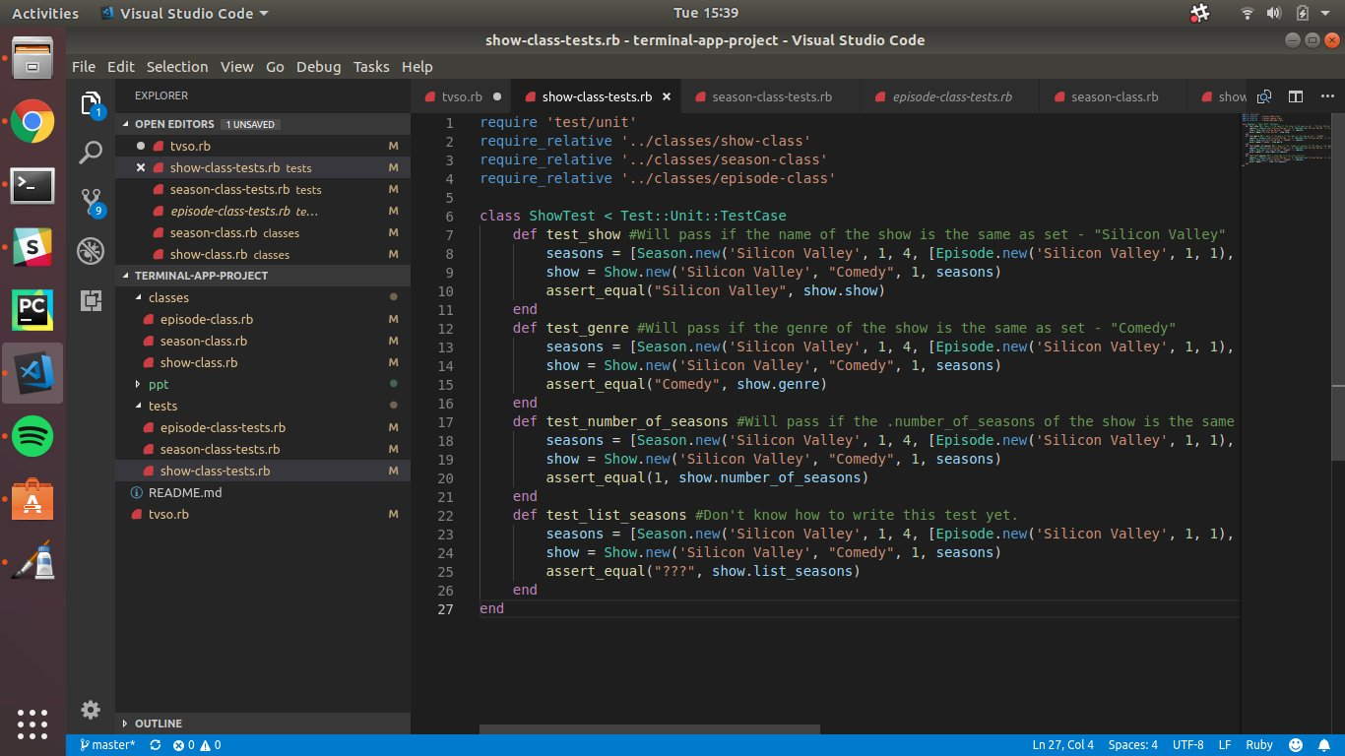
Mixed success with tests

Slide 10
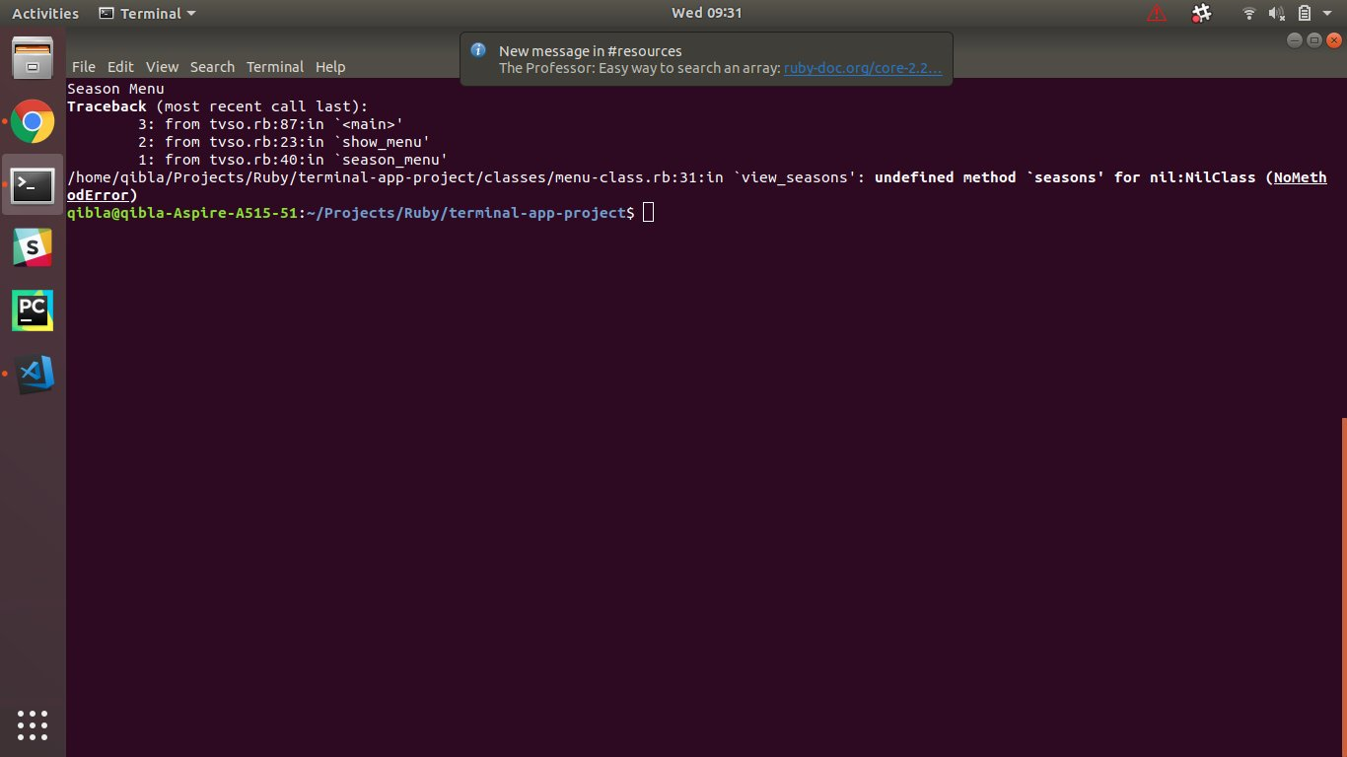
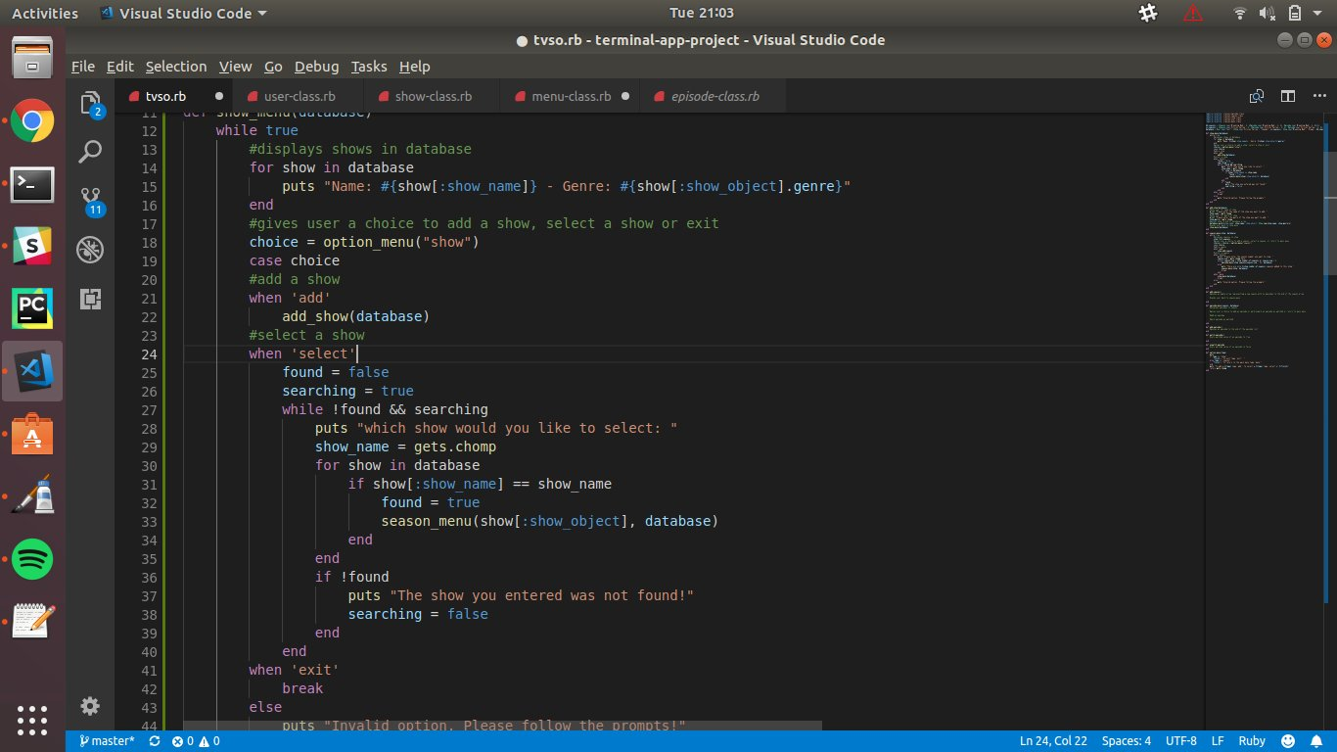
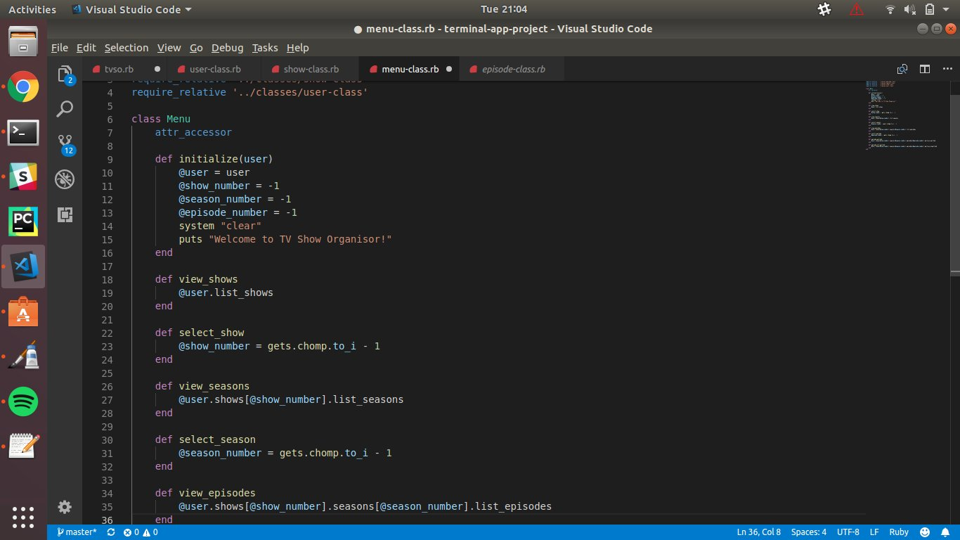
Coding
Lessons learned:
Think before you type.
Take breaks when you get frustrated.
When your code gets messy, could a class do this better?
Keep things simple and seperate.
Learn to read error messages.

Slide 11
Crashes!

Slide 12
What a mess!
This is what I call stress coding...

Slide 13
Breakthrough!

Slide 14
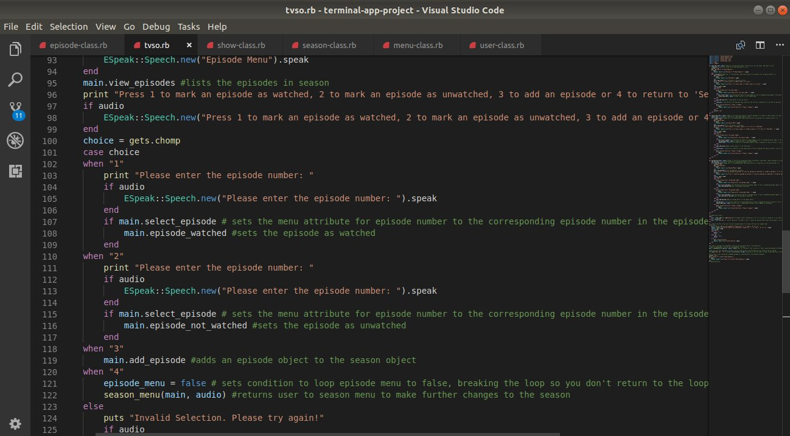
Comments Galore!

Slide 15
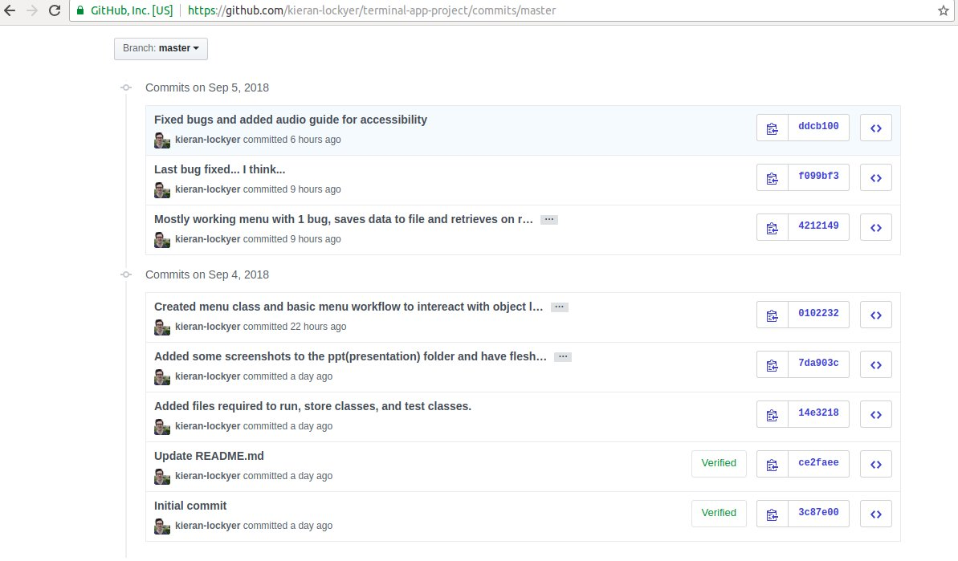
GIT

Slide 16
3. Finishing Touches
Accessibility - We added a text to speech option for visually impaired
- Advantage of OOP, very little code required to implement
Documentation - We mostly stayed true to the original outline, with only minor changes to the user workflow.
- We did use a gem to add TTS so that needed to be added to pre-requisites

Slide 17
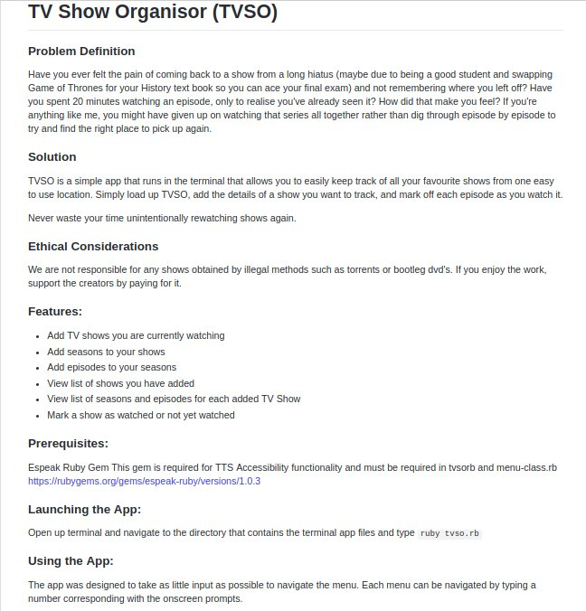
README

Slide 18
Shut Up and Show Us the Code!

Slide 19
4. Closing
Coding is fun! - ...when everything is working the way you want it to…
Learn to enjoy the struggle.

